Slide 1

Linear regression model market timing
FIN 9891-Machine Learning in Investments (Group 6)
Shefali Katoch
Luke Rhodes
Jake Johnson
Sharif Rashid

Slide 2
Model overview Introduction
Linear regression is a linear approach to modeling the relationship between a scalar response (or dependent variable) and one or more explanatory variables (or independent variables). The case of one explanatory variable is called simple linear regression.
A simple linear regression equation is y= mx+b, whereas m is the slope/gradient of the polynomial of the line aka y (predict coefficient) and b is the intercept of the line (bias coefficient).

Slide 3
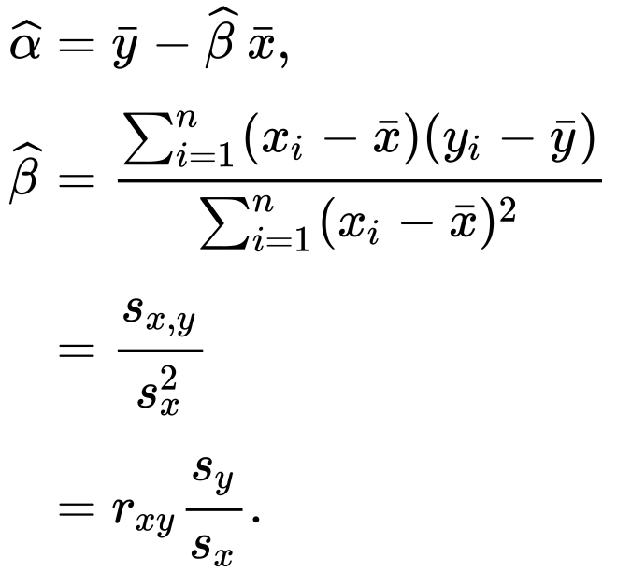
equation
b = Alpha
m = Beta

Slide 4
BENEFITS
Linear regression performs exceptionally well for linearly separable data
Easier to implement, interpret and efficient to train
It handles overfitting pretty well using dimensionally reduction techniques, regularization, and cross-validation
One more advantage is the extrapolation beyond a specific data set

Slide 5
Portfolio details

Slide 6
Historical daily prices were taken from Yahoo Finance. It provides financial news, data and commentary including stock quotes, press releases, financial reports and original content. We can make use of it to fetch the stock price of companies for any time range with a maximum limit. It allows to download CSV file containing the stock data. In this project, the stock data from 2014-2022 is used for model training and testing.
In order to evaluate the Linear regression technique of ML, it is sufficient to show that the predicted model fits the data as accurately as possible. Showing how well the model fits can therefore demonstrate that the method can be extended to predict actual future value. In this project, a Simple Linear Regression in One Variable is considered, namely the Closing Stock price for the prediction and initially plotted into the graph using plot() function. A linear model was later fit to this graph, displayed and observations were made. The data from 2014-2019 is trained being the In-sample data and the data from 2019-2022 (out of sample) is tested.
Data Collection
Analysis Method

Slide 7





stocks selection
The most actively traded stocks are chosen for this project in order to replicate
Investco QQQ.

Slide 8
pREPROCESSING dATA
In any Machine Learning process, Data Preprocessing is that step in which the data gets transformed, or Encoded, to bring it to such a state that now the machine can easily parse it. In other words, the features of the data can now be easily interpreted by the algorithm.
For this project, I have impute NaN(Not a Number) values I saw at the CSV File. We can check whether any of the element is NaN by executing this code: np.any(np.isnan(mat)) which will then output which of the column(s) have NaN value(s) and remove them: x[np.isnan(x)] = np.median(x[~np.isnan(x)])

Slide 9
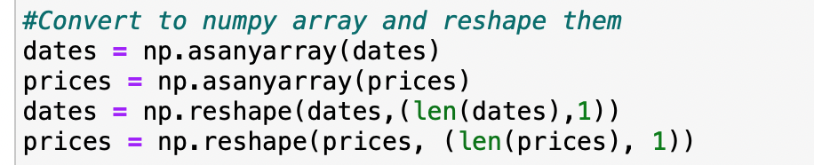
Before we fit our data into the model, we must convert them(date and prices) to numpy arrays np.asanyarray(dates) and reshape np.reshape(dates,(len(dates),1)) them as sklearn only accept numpy array or sparse matrix.
After that, we need to split our dataset to train data and test data in order to get more accurate evaluation on out of sample(data that didn't train on) accuracy xtrain, xtest, ytrain, ytest = train test split(dates, prices, test_size=0.65).
Linear Regression Model

Slide 10
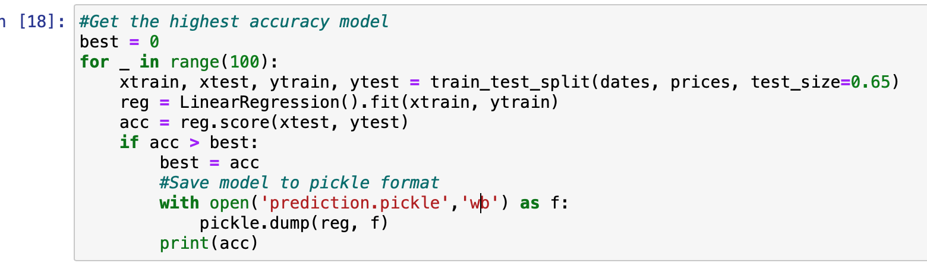
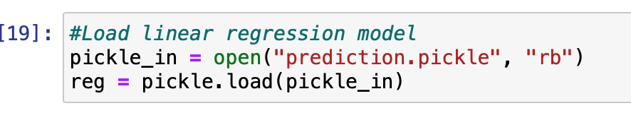
sAVING AND LOADING IN PICKLE FILE
The cons of train test splits that the it's highly dependant on which dataset is trained and tested. One way to approach this problem is to train multiple models and get the highest accuracy model.

Slide 11
Performance summary

Slide 12
model accuracy
Stock | Accuracy score
AAPL | 79.33%
AMZN | 88.87%
NVDA | 73.38%
TSLA | 59.82%
BAC | 73.54%
An average accuracy score of 50%+ suggests that the classifier model is effective.

Slide 13
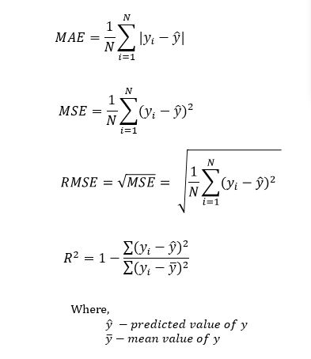
Evaluation
The method we used is R squared metric
As for the R² metric, it measures the proportion of variability in the target that can be explained using a feature X. Therefore, assuming a linear relationship, if feature X can explain (predict) the target, then the proportion is high and the R² value will be close to 1. If the opposite is true, the R² value is then closer to 0.
MSE = Mean Squared Error
MAE = Mean Absolute Error
RMSE = Root Mean Squared Error

Slide 14
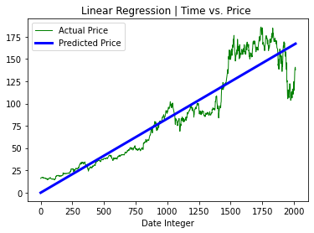
AMAZON INC
R squared | 0.88

Slide 15
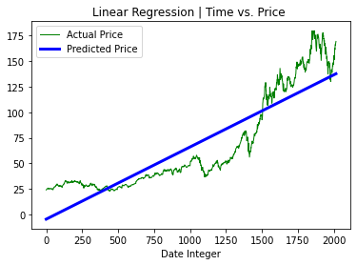
APPLE INC
R squared | 0.79

Slide 16
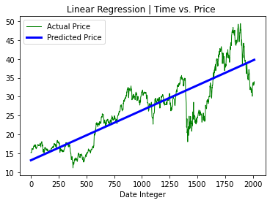
BANK OF AMERICA CORPORATION
R squared | 0.73

Slide 17
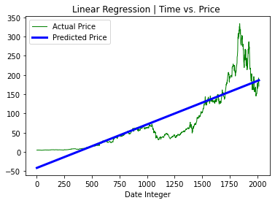
NVIDIA CORPORATION
R squared | 0.73

Slide 18
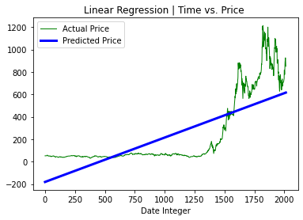
TESLA INC
R squared | 0.59

Slide 19
Looking at the data, we can see the predictions are quite close (through correlation coefficient), which gives us a direction. Since this data is reasonably accurate, we can make use of this model to aid in decision making for trading.
We can further improve this method by adding more than one independent variables. Doing so will help reduce the residual or error and help to get closer to the actual price.

Slide 20
THANK YOU

